Slide 1
Computational Graphs

Slide 2
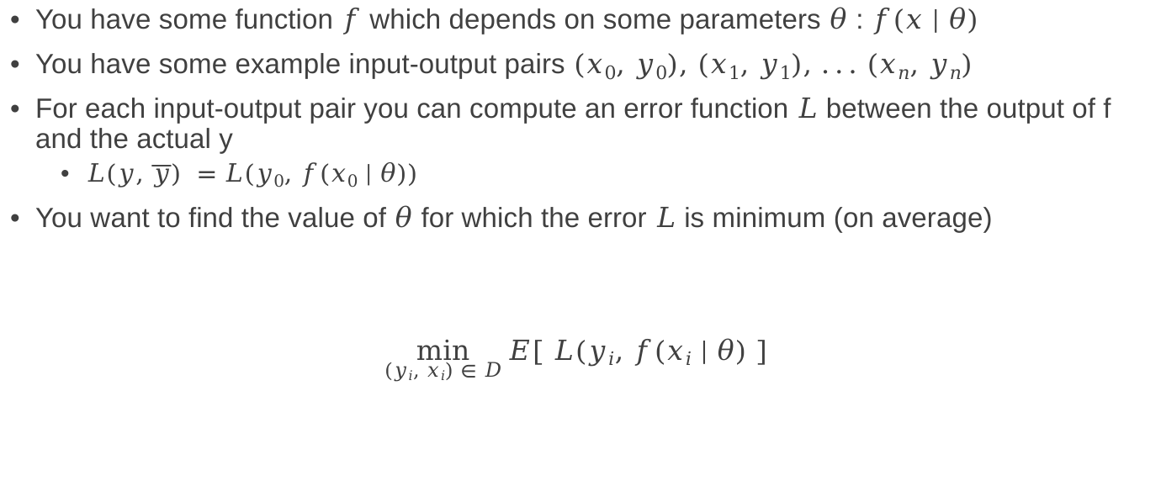
A ubiquitous problem in Machine Learning
You have some function $f$ which depends on some parameters $θ$ : $f(x | θ)$
You have some example input-output pairs $(x0, y0), (x1, y1), ... (xn, yn)$
For each input-output pair you can compute an error function $L$ between the output of f and the actual y
$L(y, \overline{y}) =L(y0, f(x0 | θ))$
You want to find the value of $θ$ for which the error $L$ is minimum (on average)
$\min_{(yi, xi) ∈ D}{E[ L(yi, f(xi | θ) ] }$

Slide 3
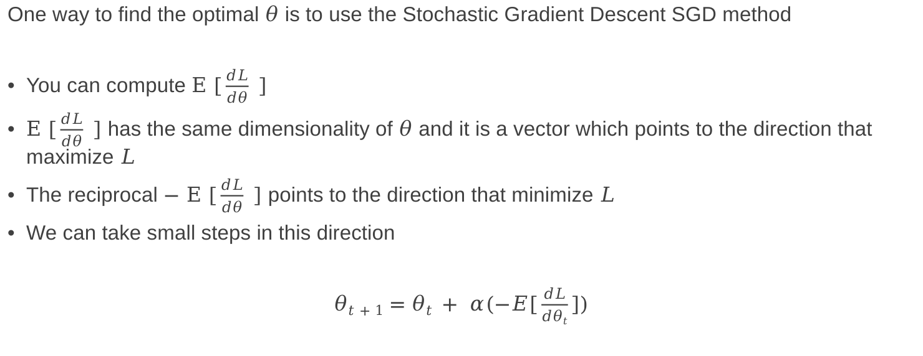
A ubiquitous problem in Machine Learning
One way to find the optimal $θ$ is to use the Stochastic Gradient Descent SGD method
You can compute $E [\frac{dL}{dθ} ]$
$E [\frac{dL}{dθ} ]$ has the same dimensionality of $θ$ and it is a vector which points to the direction that maximize $L$
The reciprocal $− E [\frac{dL}{dθ} ]$ points to the direction that minimize $L$
We can take small steps in this direction
$θt+1=θt + α(−E[\frac{dL}{dθt}])$
Demo Notebook

Slide 4


How to efficiently compute $\frac{dL}{dθ}$
There are several ways to compute $\frac{dL}{dθ}$
Manual
Not feasible for complex/deep networks
Symbolic
Computationally hard or just plain impossible
Automatic
The go-to solution for machine learning

Slide 5
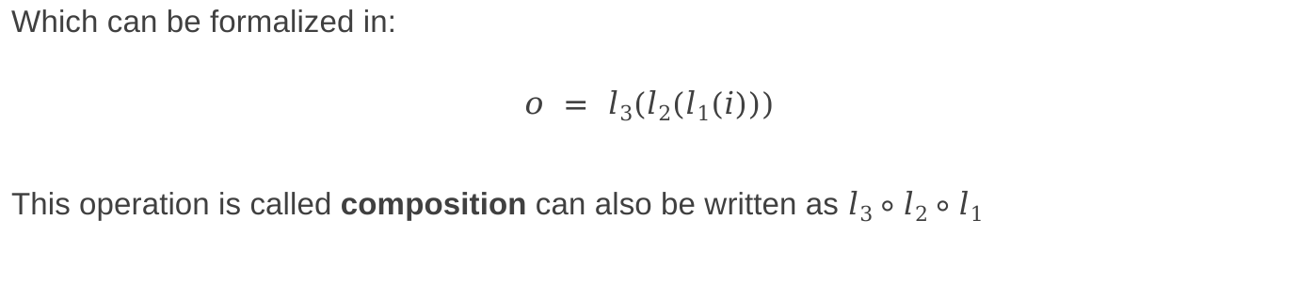
Chain Rule
A simple Machine Learning model can look like this:
Layer 1
Layer 2
Layer 3
input
output
Which can be formalized in:
$$o = l3(l2(l1(i)))$$
This operation is called composition can also be written as $l3∘l2∘l1$

Slide 6

Chain Rule
You may be familiar with this notation:
$$h(x) = f(g(x))$$
$$h’(x) = f’(g(x))g’(x)$$
Unfolding the equation from previous slide $o = l3(l2(l1(i)))$:
$$w1 = l1(i)$$
$$w2 = l2(w1)$$
$$o =l3(w2)$$
The derivative of $o$ w.r.t. $i$ is then:
$$\frac{do}{di} = \frac{do}{dw2}\frac{dw2}{dw1}\frac{dw1}{di}$$
The derivative of the composition is the multiplication of the partial derivatives (of the unfolding)

Slide 7
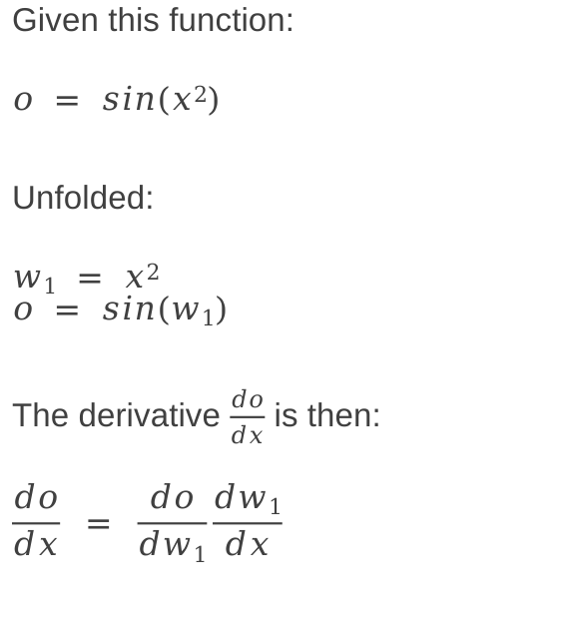

Chain Rule: Example
Given this function:
$$o = sin(x2)$$
Unfolded:
$$w1 = x2$$
$$o = sin(w1)$$
The derivative $\frac{do}{dx}$ is then:
$$\frac{do}{dx} = \frac{do}{dw1}\frac{dw1}{dx}$$
$$\frac{do}{dw1} = \frac{d(sin(w1))}{dw1} = cos(w1) = cos(x2)$$
$$\frac{dw1}{dx} = \frac{d(x2)}{dx} = 2x$$
Finally:
$$\frac{do}{dx} = \frac{do}{dw1}\frac{dw1}{dx} = cos(x2)2x$$

Slide 8
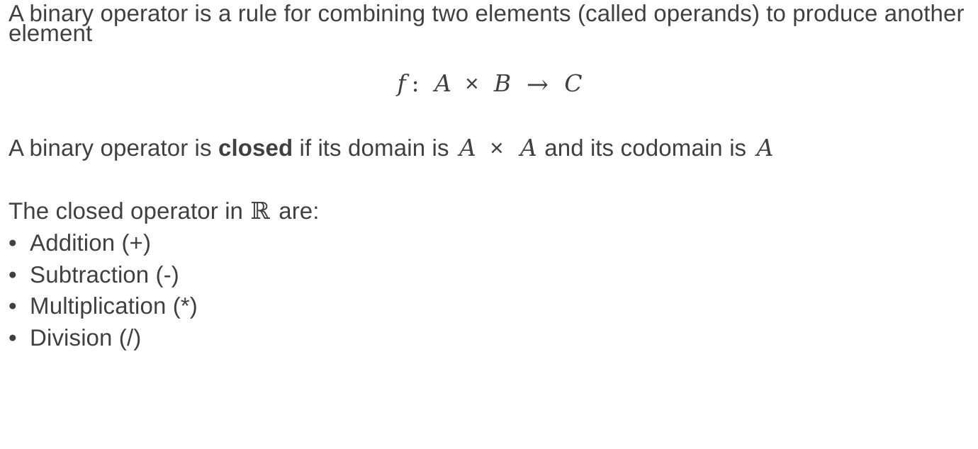
Chain Rule: Binary Operators
A binary operator is a rule for combining two elements (called operands) to produce another element
$$f: A × B → C$$
A binary operator is closed if its domain is $A × A$ and its codomain is $A$
The closed operator in $ℝ$ are:
Addition (+)
Subtraction (-)
Multiplication (*)
Division (/)

Slide 9
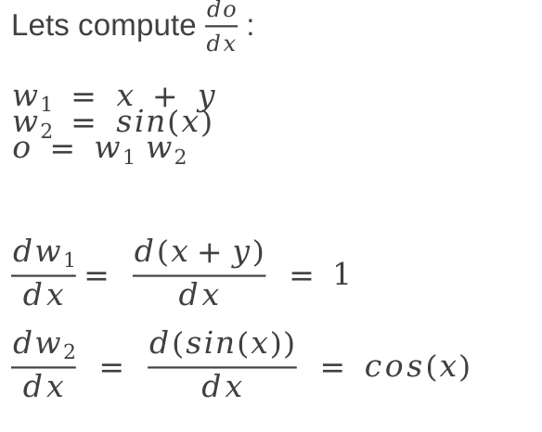
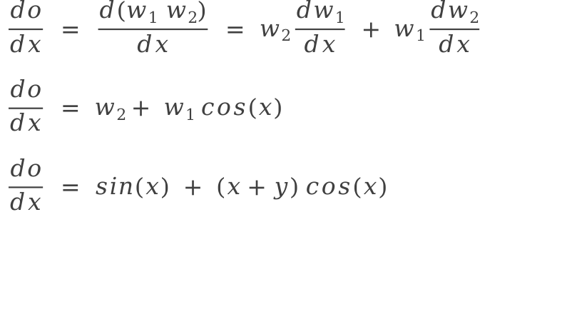
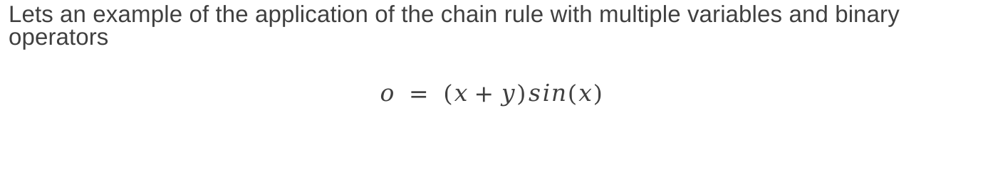
Chain Rule: Multiple Variables with Binary Operators
Lets an example of the application of the chain rule with multiple variables and binary operators
$$o = (x+y)sin(x)$$
Lets compute $\frac{do}{dx}$ :
$$w1 = x + y$$
$$w2 = sin(x)$$
$$o = w1 w2$$
$$\frac{dw1}{dx}= \frac{d(x+y)}{dx} = 1$$
$$\frac{dw2}{dx} = \frac{d(sin(x))}{dx} = cos(x)$$
$$\frac{do}{dx} = \frac{d(w1 w2)}{dx} = w2\frac{dw1}{dx} + w1\frac{dw2}{dx}$$
$$\frac{do}{dx} = w2+ w1 cos(x)$$
$$\frac{do}{dx} = sin(x) + (x+y) cos(x)$$
The binary operator caused a split on the derivation flow!

Slide 10
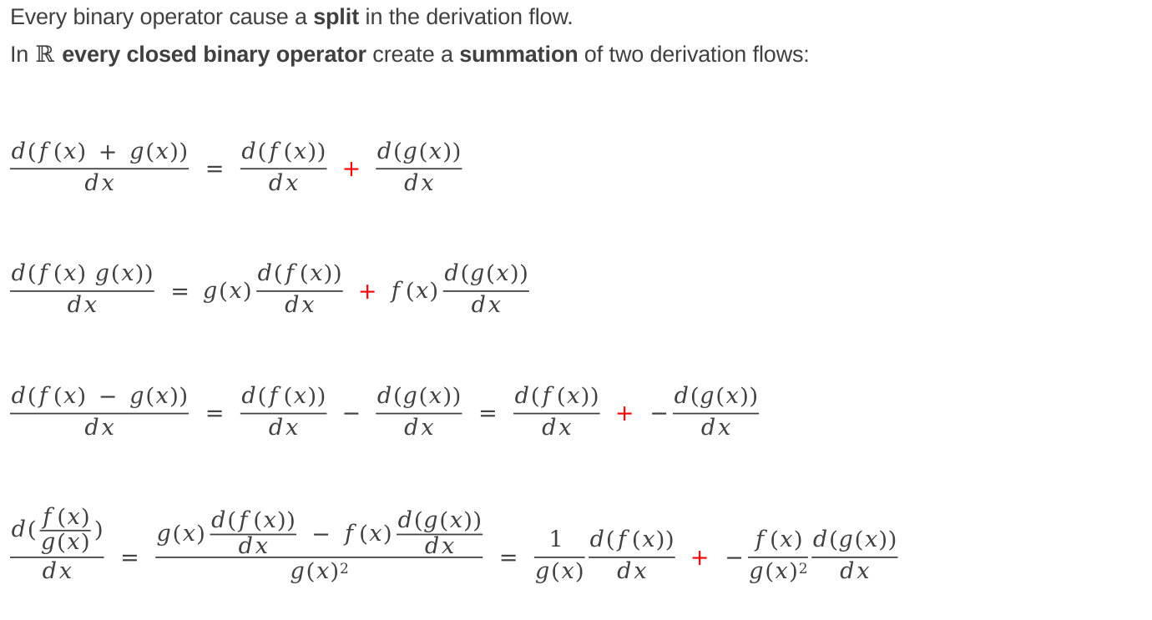
Chain Rule: Binary Operators
Every binary operator cause a split in the derivation flow.
In $ℝ$ every closed binary operator create a summation of two derivation flows:
$$\frac{d(f(x) + g(x))}{dx} = \frac{d(f(x))}{dx} + \frac{d(g(x))}{dx}$$
$$\frac{d(f(x) g(x))}{dx} = g(x)\frac{d(f(x))}{dx} + f(x)\frac{d(g(x))}{dx}$$
$$\frac{d(f(x) − g(x))}{dx} = \frac{d(f(x))}{dx} − \frac{d(g(x))}{dx} = \frac{d(f(x))}{dx} + −\frac{d(g(x))}{dx}$$
$$\frac{d(\frac{f(x)}{g(x)})}{dx} = \frac{g(x)\frac{d(f(x))}{dx} − f(x)\frac{d(g(x))}{dx}}{g(x)2} = \frac{1 }{g(x)}\frac{d(f(x))}{dx} + −\frac{f(x)}{g(x)2}\frac{d(g(x))}{dx}$$

Slide 11
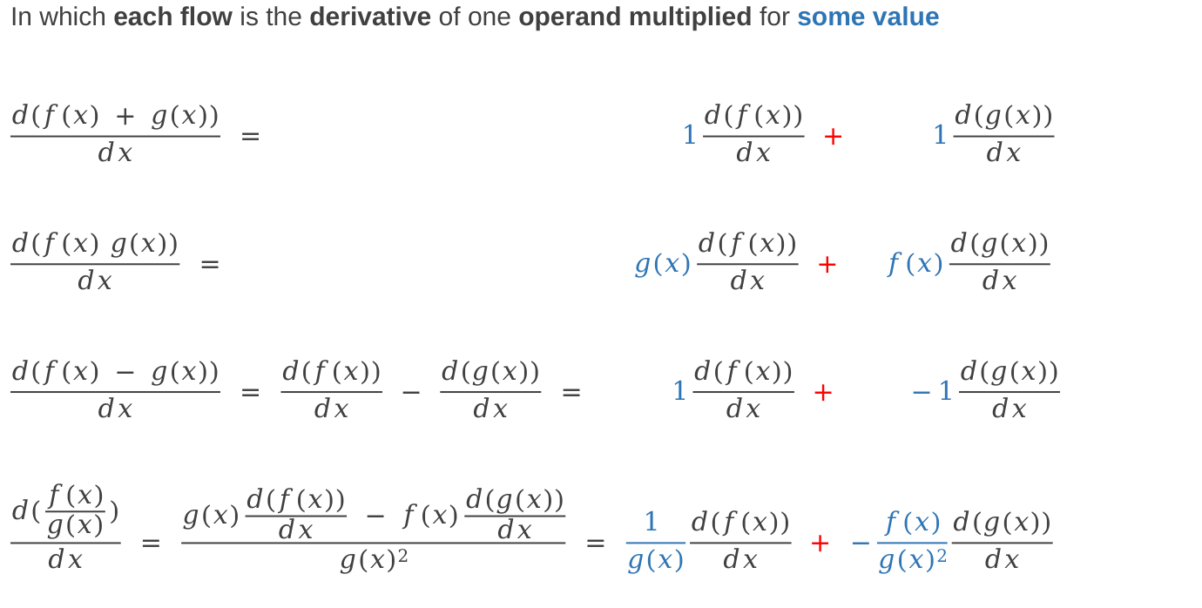
Chain Rule: Binary Operators
In which each flow is the derivative of one operand multiplied for some value
$$\frac{d(f(x) + g(x))}{dx} = 1\frac{d(f(x))}{dx} + 1\frac{d(g(x))}{dx}$$
$$\frac{d(f(x) g(x))}{dx} = g(x)\frac{d(f(x))}{dx} + f(x)\frac{d(g(x))}{dx}$$
$$\frac{d(f(x) − g(x))}{dx} = \frac{d(f(x))}{dx} − \frac{d(g(x))}{dx} = 1\frac{d(f(x))}{dx} + −1\frac{d(g(x))}{dx}$$
$$\frac{d(\frac{f(x)}{g(x)})}{dx} = \frac{g(x)\frac{d(f(x))}{dx} − f(x)\frac{d(g(x))}{dx}}{g(x)2} = \frac{1 }{g(x)}\frac{d(f(x))}{dx} + −\frac{f(x)}{g(x)2}\frac{d(g(x))}{dx}$$

Slide 12
Computational Graphs
Computational graphs are a way of expressing and evaluating a mathematical expression
Each operator is represent with a node
A node can have one or more inputs and one output.
x+y
x*y
+
*
x
y
x
y

Slide 13

Computational Graphs: Composition
A composition in a computational graph is a simple flow.
For example $o = g(f(x))$:
f
g
x
o
We can use a Computational Graph to compute the derivatives of an expression
The first method we will see its called reverse mode differentiation

Slide 14




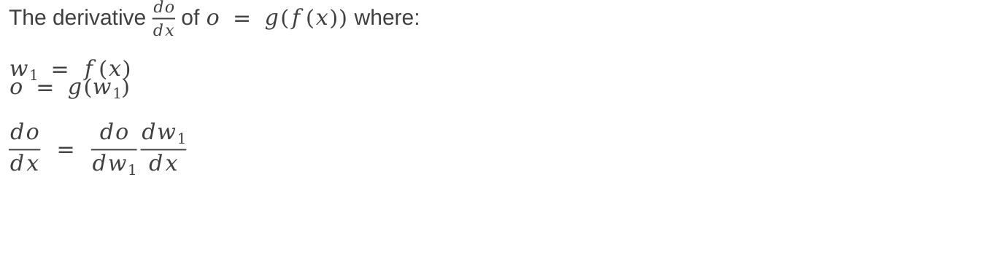
Computational Graphs: Composition differentiation
The derivative $\frac{do}{dx}$ of $o = g(f(x))$ where:
$$w1 = f(x)$$
$$o = g(w1)$$
$$\frac{do}{dx} = \frac{do}{dw1}\frac{dw1}{dx}$$
Composition in the forward path
f
$$w1$$
g
x
o
$$\frac{dw1}{dx}$$
$$\frac{do}{dw1}$$
$$\frac{do}{do} = 1$$
Multiplication in the backward path

Slide 15






Computational Graphs: Binary Operator differentiation (dx branch)
The derivative $\frac{do}{dx}$ of $o = f(x)g(y)$ where:
$$w1 = f(x)$$
$$w2 = g(y)$$
$$o = w1w2$$
$$\frac{do}{dx} = w2\frac{dw1}{dx} + w1\frac{dw2}{dx} =$$
$$= g(y)\frac{d(f(x))}{dx} + f(x)\frac{d(g(y))}{dx}$$
$$= g(y)\frac{d(f(x))}{dx}$$
$$f(x)g(y)$$
*
$$g(y)$$
$$\frac{d(f(x))}{dx}$$
$$f(x)$$
$$g(y)$$
This is zero!

Slide 16


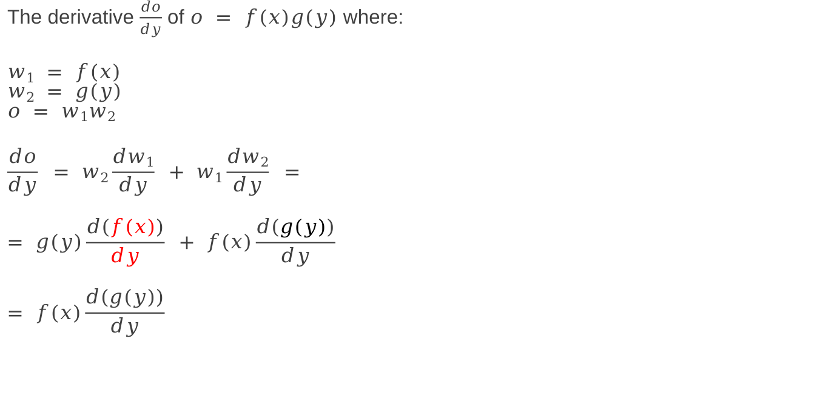
Computational Graphs: Binary Operator differentiation (dy branch)
The derivative $\frac{do}{dy}$ of $o = f(x)g(y)$ where:
$$w1 = f(x)$$
$$w2 = g(y)$$
$$o = w1w2$$
$$\frac{do}{dy} = w2\frac{dw1}{dy} + w1\frac{dw2}{dy} =$$
$$= g(y)\frac{d(f(x))}{dy} + f(x)\frac{d(g(y))}{dy}$$
$$= f(x)\frac{d(g(y))}{dy}$$
$$f(x)g(y)$$
*
$$f(x)$$
$$f(x)$$
$$g(y)$$
$$\frac{d(g(y))}{dy}$$
This is zero!

Slide 17
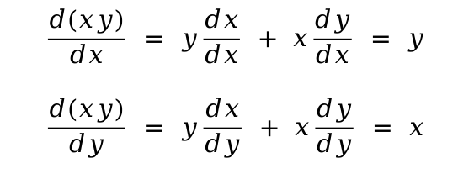
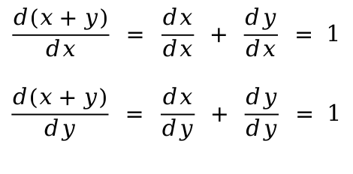
Computational Graphs: Addition and Multiplication nodes
x+y
x*y
+
*
1
1
y
x
x
y
x
y
$$\frac{d(x+y)}{dx} = \frac{dx}{dx} + \frac{dy}{dx} = 1$$
$$\frac{d(x+y)}{dy} = \frac{dx}{dy} + \frac{dy}{dy} = 1$$
$$\frac{d(xy)}{dx} = y\frac{dx}{dx} + x\frac{dy}{dx} = y$$
$$\frac{d(xy)}{dy} = y\frac{dx}{dy} + x\frac{dy}{dy} = x$$

Slide 18
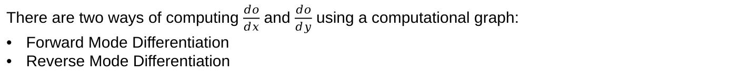



Computational Graphs: Example
Let compute the Computational Graph of $o = (x+y)sin(x)$
$$cos(x)$$
sin
x
$$x+y$$
1
*
1
o
+
$$sin(x)$$
1
y
There are two ways of computing $\frac{do}{dx}$ and $\frac{do}{dy}$ using a computational graph:
Forward Mode Differentiation
Reverse Mode Differentiation

Slide 19




Computational Graphs: Generalization
$$\frac{dw1}{dx}$$
w₁
$$\frac{dw3}{dw1}$$
x
w₃
$$\frac{dw2}{dx}$$
o
w₂
$$\frac{dw3}{dw2}$$
$$cos(x)$$
sin
x
$$x+y$$
$$\frac{dw2}{dy}$$
y
1
*
1
o
+
$$sin(x)$$
1
y

Slide 20
Computational Graphs: Reverse Mode Differentiation
Because each path is a composition of operations
Lets start with the Reverse Mode Differentiation
$$cos(x)$$
sin
x
$$x+y$$
Because each split represent a binary operator with two derivation flows to be summed
1
*
1
o
+
$$sin(x)$$
1
y
To compute the derivative of the output w.r.t. to one input you have to find all possible paths from the output to the input and multiply the partial values over each path and sum all the results

Slide 21


Computational Graphs: Example $\frac{do}{dx}$ in reverse mode
$$cos(x)$$
sin
x
$$x+y$$
1
*
1
o
+
$$sin(x)$$
1
y
$$\frac{do}{dx}= (x+y)cos(x) + sin(x)$$

Slide 22


Computational Graphs: Example $\frac{do}{dy}$ in reverse mode
$$cos(x)$$
sin
x
$$x+y$$
1
*
1
o
+
$$sin(x)$$
1
y
$$\frac{do}{dy}= sin(x)$$

Slide 23
Computational Graphs: Generalization Reverse Mode
$$\frac{dw1}{dx}$$
w₁
$$\frac{dw3}{dw1}$$
x
w₃
$$\frac{dw2}{dx}$$
o
w₂
$$\frac{dw3}{dw2}$$
$$\frac{dw2}{dy}$$
In Reverse Mode Differentiation you can compute the partial derivatives of one output with respect to every input in one pass
y

Slide 24


Computational Graphs: Forward Mode Differentiation
$$\frac{dw1}{dx}$$
w₁
$$\frac{dw3}{dw1}$$
$$\frac{dx}{dx} = 1$$
x
w₃
$$\frac{dw2}{dx}$$
o
Start here!
Let’s differentiate w.r.t. x
$$\frac{dw3}{dw2}$$
w₂
$$\frac{dw2}{dy}$$
$$\frac{dy}{dx} = 0$$
y
Start from the inputs, set the initial derivative of the variable you want to compute w.r.t. to 1. Set the other derivatives to 0.
Compute forward multiplying the values over the edges and summing when joining paths

Slide 25






Computational Graphs: Example $\frac{do}{dx}$ in forward mode
$$cos(x)$$
sin
1
x
$$x+y$$
$$cos(x)$$
$$cos(x)(x+y)$$
*
1
o
$$(x+y)cos(x) + sin(x)$$
1
$$sin(x)$$
1
$$sin(x)$$
1
+
0
y
0
$$\frac{do}{dx}= (x+y)cos(x) + sin(x)$$

Slide 26







Computational Graphs: Example $\frac{do}{dy}$ in forward mode
$$cos(x)$$
sin
$$\frac{dx}{dy}=0$$
$$x+y$$
x
$$0$$
$$0$$
*
1
o
$$sin(x)$$
1
$$sin(x)$$
0
$$sin(x)$$
1
+
$$\frac{dy}{dy}=1$$
1
y
$$\frac{do}{dy}= sin(x)$$

Slide 27
Computational Graphs: Generalization Forward Mode
$$\frac{dw1}{dx}$$
w₁
$$\frac{dw3}{dw1}$$
x
w₃
$$\frac{dw2}{dx}$$
o
w₂
$$\frac{dw3}{dw2}$$
$$\frac{dw2}{dy}$$
In Forward Mode Differentiation you can compute the partial derivatives of every output with respect to one input in one pass
y

Slide 28
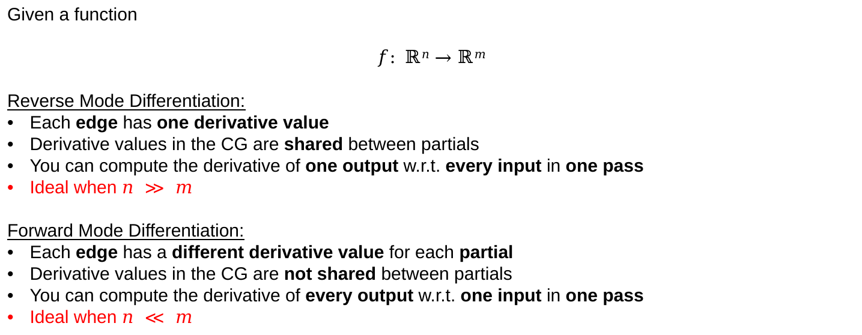
Computational Graphs: Trade-offs
Given a function
$$f: ℝn→ℝm$$
Reverse Mode Differentiation:
Each edge has one derivative value
Derivative values in the CG are shared between partials
You can compute the derivative of one output w.r.t. every input in one pass
Ideal when $n ≫ m$
Forward Mode Differentiation:
Each edge has a different derivative value for each partial
Derivative values in the CG are not shared between partials
You can compute the derivative of every output w.r.t. one input in one pass
Ideal when $n ≪ m$
Machine learning error functions are: $f: ℝn→ℝ$(where $n$ can be several billions)

Slide 29



Computational Graphs: Numerical Differentiation Frameworks
There are several Numerical Differentiation Frameworks
All these Machine Learning frameworks use reverse mode computational graphs under the hood.
They provide nice abstract APIs to easily build complex architectures.

Slide 30
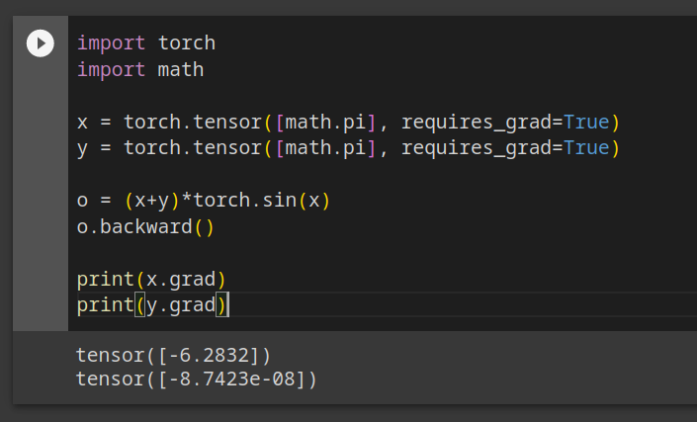
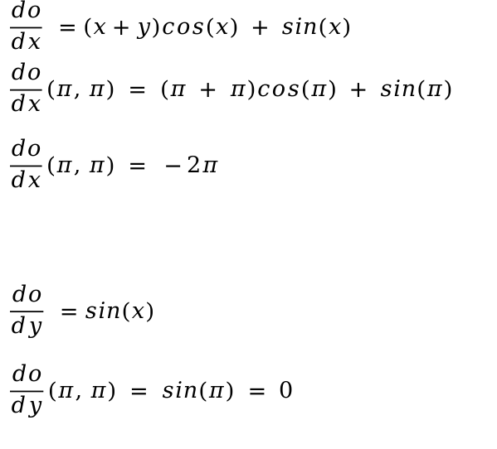
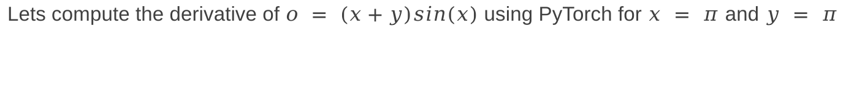
Computational Graphs: PyTorch Example
Lets compute the derivative of $o = (x+y)sin(x)$ using PyTorch for $x = π$ and $y = π$
$$\frac{do}{dx} =(x+y)cos(x) + sin(x)$$
$$\frac{do}{dx}(π, π) = (π + π)cos(π) + sin(π)$$
$$\frac{do}{dx}(π, π) = −2π$$
$$\frac{do}{dy} =sin(x)$$
$$\frac{do}{dy}(π, π) = sin(π) = 0$$

Slide 31
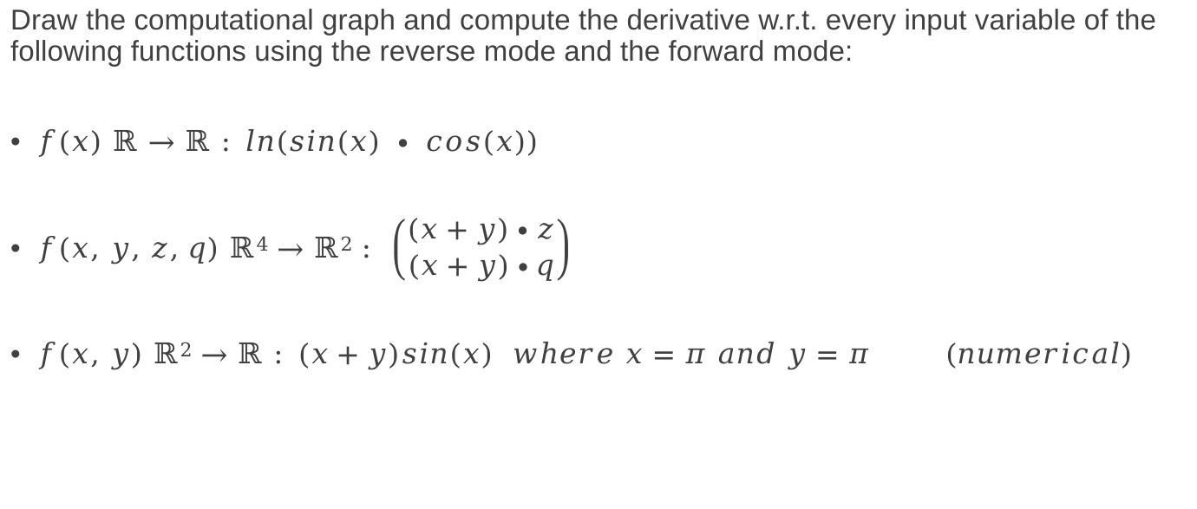
Exercises
Draw the computational graph and compute the derivative w.r.t. every input variable of the following functions using the reverse mode and the forward mode:
$f(x) ℝ→ℝ : ln(sin(x) ∙ cos(x))$
$f(x, y, z, q) ℝ4→ℝ2 : \left(\begin{matrix}(x+y)∙z \\ (x+y)∙q\end{matrix}\right)$
$f(x, y) ℝ2→ℝ : (x+y)sin(x) where x=π and y=π (numerical)$

